Slide 1
Apriori Algorithm
Made by Leyan

Slide 2
Outline
DataSet
Apriori
Apriori (Hash Tree)
FP-Growth

Slide 3
DataSet
Kaggle : https://www.kaggle.com/xvivancos/transactions-from-a-bakery/home
DataName : Transactions from a bakery
Column : {Date , Time , Transaction , Item}
Column Date. (YYYY-MM-DD format). From 30/10/2016 to 09/04/2017.
Time. (HH:MM:SS format).
Transaction. The rows that share the same value in this field belong to the same transaction.
Item. Categorical variable with the products

Slide 4
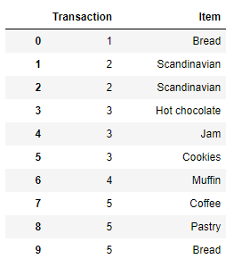
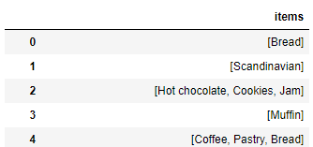
DataSet
Data Preprocessing

Slide 5
DataSet
DataName : IBM
Column : {TID , Transaction , Item}
Number of transactions in database = 1000
Average transaction length = 5
Number of items = 50000
Large Itemsets:
Number of patterns = 500
Average length of pattern = 3
Correlation between consecutive patterns = 0.25
Average confidence in a rule = 0.75
Variation in the confidence = 0.1
Notes:
"IBM Quest Data Generator.exe" lit -ntrans 1 -tlen 5 -nitems 50 -npats 500 -patlen 3

Slide 6
Apriori

Slide 7
Apriori (Hash Tree)

Slide 8
FP-Growth

